Slide 1

SIG React
04-09-2018

Slide 2
Recap
Props, State, Routes, Fetch
React

Slide 3
Context API
Create context using React.createContext
Note: when using the contextType notation, create a seperate file to prevent circular dependencies
If you want to pass functions, put them in state and pass the whole state object
React

Slide 4
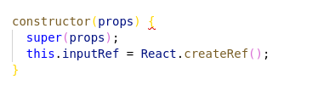

Uncontrolled forms
Initialise the ref in the constructor:
Use a callback to link the DOM element to the ref
The value of the ref is available in `this.inputRef.value`
For Material UI <Input /> or <TextField /> use inputRef instead of ref
React

Slide 5

Hands-on Time!
Questions?
React

Slide 6
Hands-on: Getting started
Git clone https://github.com/AMIS-Services/react-series
Cd into dir sig3/exercise/koa, run:
  `yarn install`
  `yarn stop-db` (in case you were still running the container since last SIG :))
  `yarn start-db`
  `yarn start`
  `yarn seed-db`
Visit localhost:3030/accommodations to verify back-end is working
Cd into dir sig3/exercise/react, run `yarn install` and `yarn start`
Visit localhost:3000 to verify front-end is working
React

Slide 7
Hands-on: Setting up a user context
WHAT: Build a login flow
Create a file called context.js in `src/common`
Initialise a context called UserContext and export it
Import the context in Frame.js and use it in a <UserContext.provider />
Add state to the Frame component, consisting of a currently undefined user and a login function
In the login function, use the login function from src/common/auth.js. Set state.user to the user returned by the login function from auth.js
As the UserContext value pass entire state
Wrap the JSX the Appbar returns in a <UserContext.Consumer /> and conditionally show either the users userName or the word login
BONUS: Add logging out
React

Slide 8
Hands-on: Uncontrolled form
Create a LoginDialog component, pass it the properties open (a boolean) and handleClose (a function)
In the render method, return a MUI <Dialog />. Pass it the property open from your LoginDialog props.
Add two Inputs for email and password as well as a Button from MUI
Initialize two refs in the constructor and add them to the Inputs using callbacks in their inputRef property
Create a handleLogin function and add it to the onClick of the button.
Below your class, add `LoginDialog.contextType = UserContextAdd the login logic from your context to your handleLogin function.
Change the <Appbar /> render to contain the <LoginDialog />. Add the necessary functions and state members to manage the `open` prop of the LoginDialog. Pass LoginDialog the necessary function in handleClose
BONUS: make the ‘favorite’ on the accommodations work again. The favorite accommodations list can be found on the user object.
BONUS: add validation to the ‘email’ field of the login dialog
React

Slide 9
Hands-on: Controlled form
Add a new page at `/create`
Add a MUI TextField for name, location, foto url, description and a MUI (multi)Select for amenities (faciliteiten)
Have the input values depend on state and add functions for the inputs’ `onChange`
Add a submit button which posts the accomodation to `localhost:3030/accommodations` using the fetch function from ‘src/common/fetc’
Bonus: add a create new user page at `/register` using a controlled form
React

Slide 10
Hands-on: Redux actions
Create a file: src/store/accommodations/actions.js
Export a function getAllAccommodations which returns an async function which takes a parameter called dispatch. HINT: this async means you will want to use `await`.
In the returned function, dispatch an object with the attribute type set to “REQUEST_ACCOMMODATIONS”
Move the accommodations fetch from Accommodations.js to here
If the Fetch is successful dispatch a second object with type “RECEIVE_ACCOMMODATIONS” and the accommodations as payload. If the Fetch is unsuccessful dispatch an object with type “ERROR_ACCOMMODATIONS”
Suggestion: put the type strings in a constant which you export, so you can use the same strings later
React

Slide 11
Hands-on: Redux reducer
Create a file: src/store/accommodations/reducer.js
Add the reducer function
It takes a state (default empty array) and an action (default empty object)
It contains a switch for the action.type
By default it returns the state
Add a case for ‘REQUEST_ACCOMMODATIONS’, ‘ERROR_ACCOMMODATIONS’ and ‘RECEIVE_ACCOMMODATIONS’
In the request and error case return state
In the receive case put the accommodations you just fetched in the state
React

Slide 12
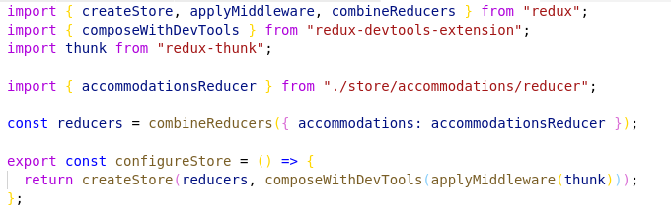
Hands-on: Redux store
Create a store configuration file in src/store:
Initialize and provide the store by assigning the return from configureStore() to a constant in your App.js. Wrap <Provider /> from react-redux around the rest of your app.
React

